Slide 1

UNECE RxSWIN Requiremets Analysis
Daniel Andris
Jan 22, 2020

Slide 2
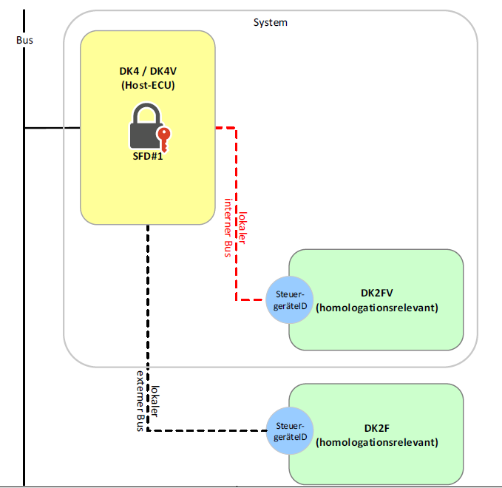
RxSWIN Scope
RGS is a programmable and configurable 2F diagnostic class system.
What must be ensured:
EPDS (ECU programming data security)
IVD (Integrity validation data)
- for program data (app + fbl)
- for configuration data

Slide 3
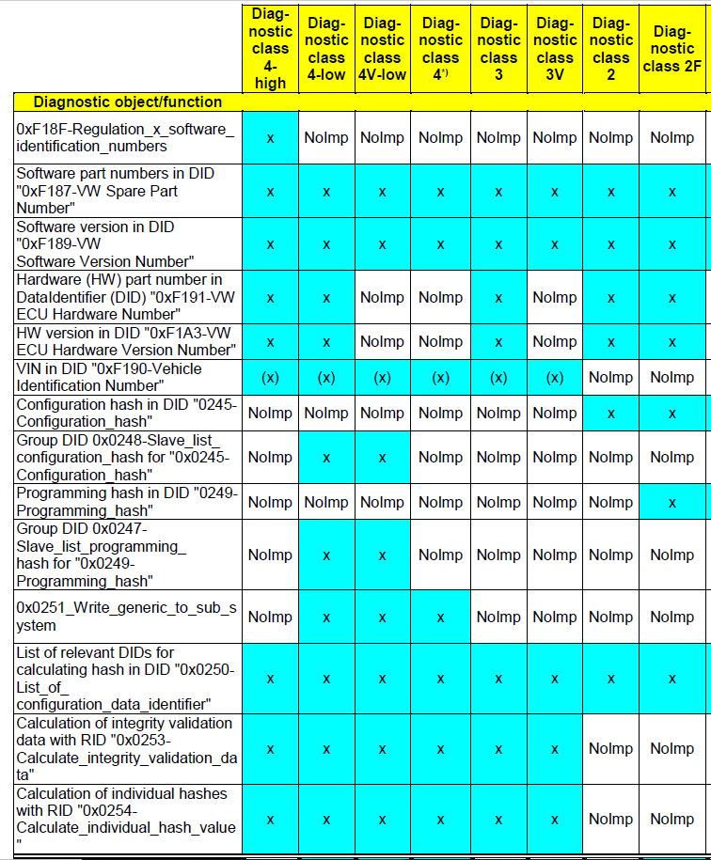
RxSWIN Scope
New diag services to implement:
"0xF187-VW Spare Part Number“
"0xF189-VW Software Version Number“
"0xF191-VW ECU Hardware Number“
"0xF1A3-VW ECU Hardware Version Number“
"0245-Configuration_hash“
"0249-Programming_hash“
"0x0250-List_of_ configuration_data_identifier“
Change of existing diag services and implementation of exceptions to existing VW group standards.

Slide 4
Technical Challenges
Integrate VW Standard software module for IVD – unknown size (RAM & Flash) and CPU load requirements
It must not take more than 100 ms to calculate the hash – not only dependent on ALV application and microcontroller, but also on VW algo performance and complexity.
Memory consumption requirements (70% does not include change for RxSWIN) – valid for any change request
So far, technically, there is no show stopper

Slide 5
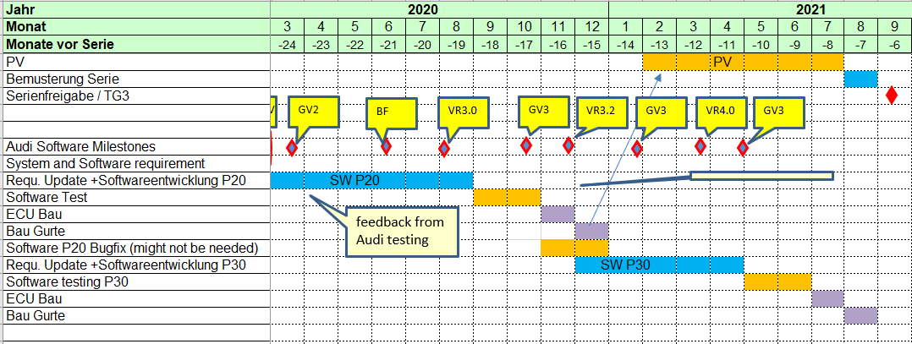
Project Challenges
Project Timing
additional time to implement the RxSWIN CR
it could be implemented after P20, depends on the time when the VW package will be delivered to ALV
Project Cost
the effort estimation is not done yet (cost not evaluated at the moment)
also depends on the content of the VW Standard software module for IVD

Slide 6
Next Steps
Analyze the effort for implementing everything except the hash algo for IVD
Get the content of the VW Standard software module in terms of functionality (what will VW implement and what ALV must implement).
Update the ALV effort estimation if necessary (if VW implements only the hash algo, then this step is not necessary).
Agree on the implementation timing (when).
Create the cost estimation.

